Slide 1

Enhancing Student Engagement with AI-Powered Insights
Final Week Presentation – AI-Powered Data Insights
Presented by SHRUTHI

Slide 2



Executive Summary- What is our Project about?
Explored learner engagement across 3 weeks of data
Identified predictors of drop-off using machine learning
Designed a personalized recommendation system
Delivered actionable strategies to improve retention

Slide 3
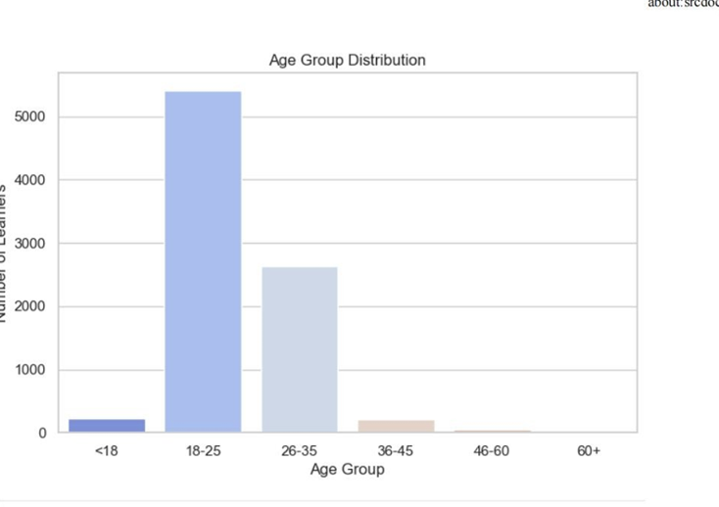
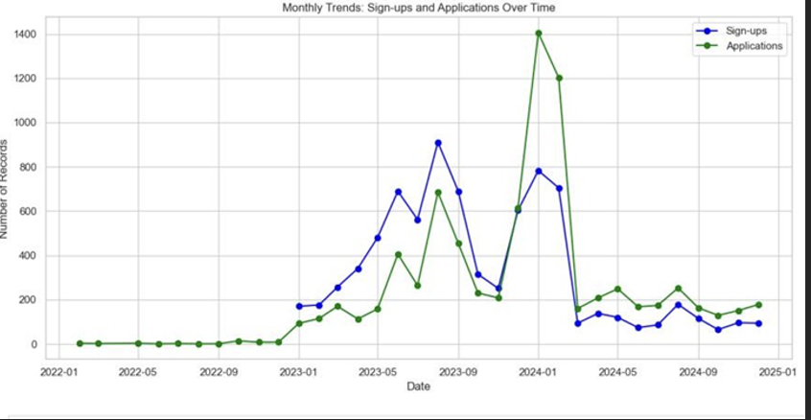
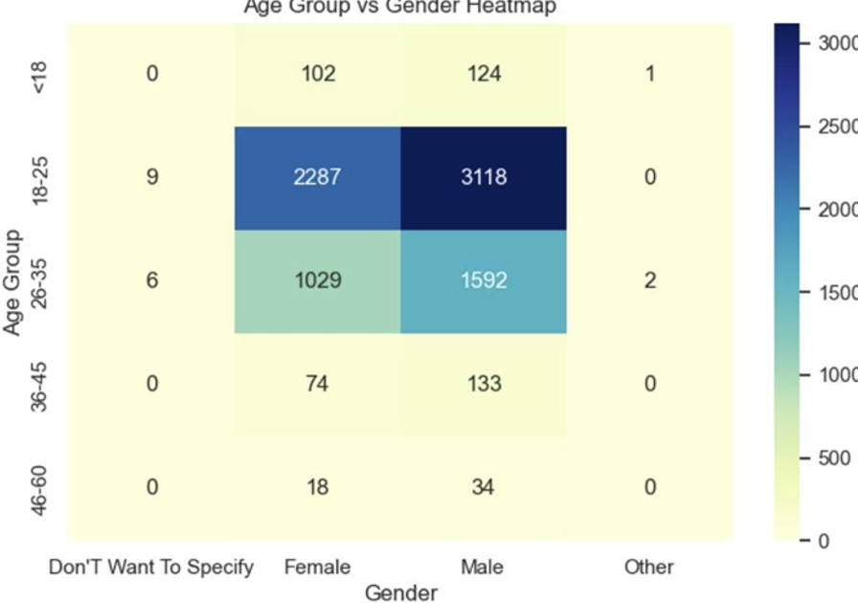
Insights from Data
What the Data Told Us (Weeks 1 & 2)
Majority of learners were 18–35 years old
Sign-up spikes during June and December
Delayed application = higher drop-off risk
Top majors: Computer Science, Engineering, Business
Notes:
Visuals: Bar chart (age group), line chart (signup trends), heatmap (engagement by age/gender)

Slide 4
Predicting Who Stays and Who Drops
Churn Rate: 1.23%
Strongest predictors: Application lag and age
Models used: Decision Tree, Random Forest, Logistic Regression
Logistic Regression had best balance of precision & recall
Modeling Student Churn

Slide 5
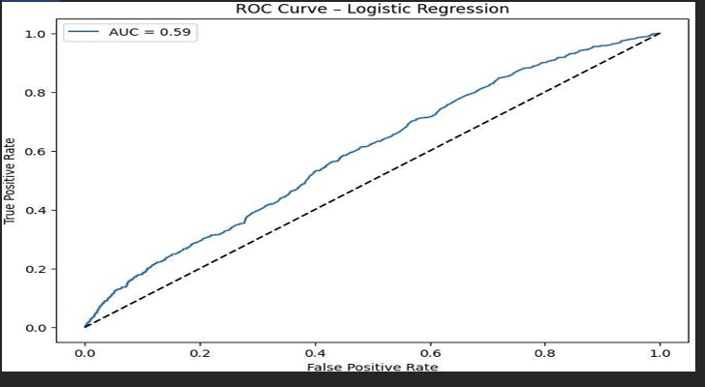
ROC curve or Feature Importance chart

Slide 6
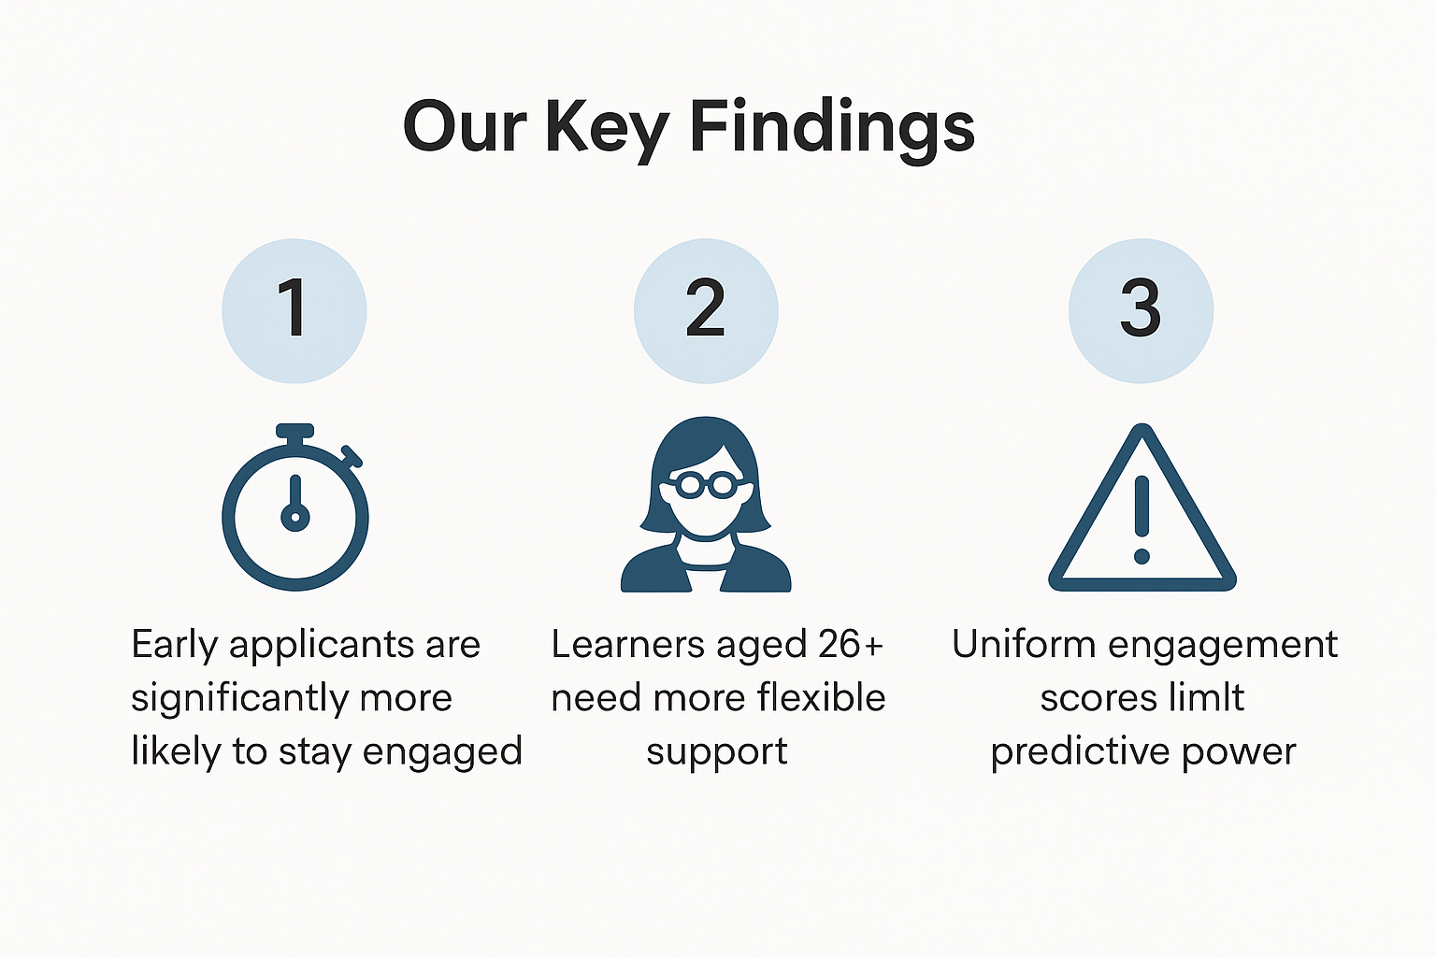
Our Key Findings - Our Top 3 Insights for actions
Early applicants are significantly more likely to stay engaged
Learners aged 26+ need more flexible, supportive structures
Uniform engagement scores limit predictive power

Slide 7
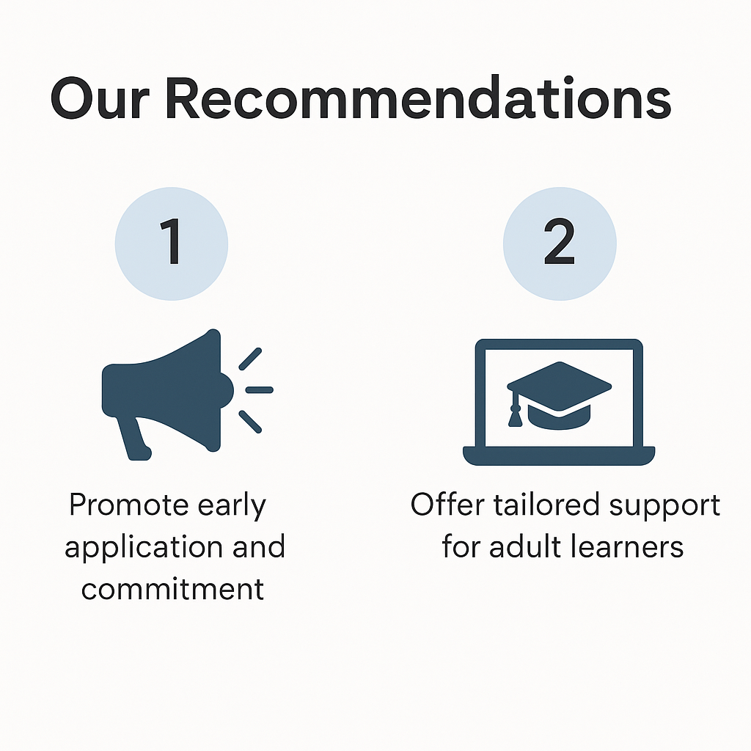
Personalized Solutions to Reduce Drop-Off
Inputs: Age, Country, Application Lag, Composite Score
Outputs: Nudges, mentoring, localized content, project templates
Powered by rule-based content filtering

Slide 8

Platform Recommendations
What We Recommend Going Forward
Send automated nudges within 48 hours of signup
Prioritize shorter opportunities (≤30 days)
Offer targeted support for older learners
Expand behavioral data collection for richer analysis

Slide 9
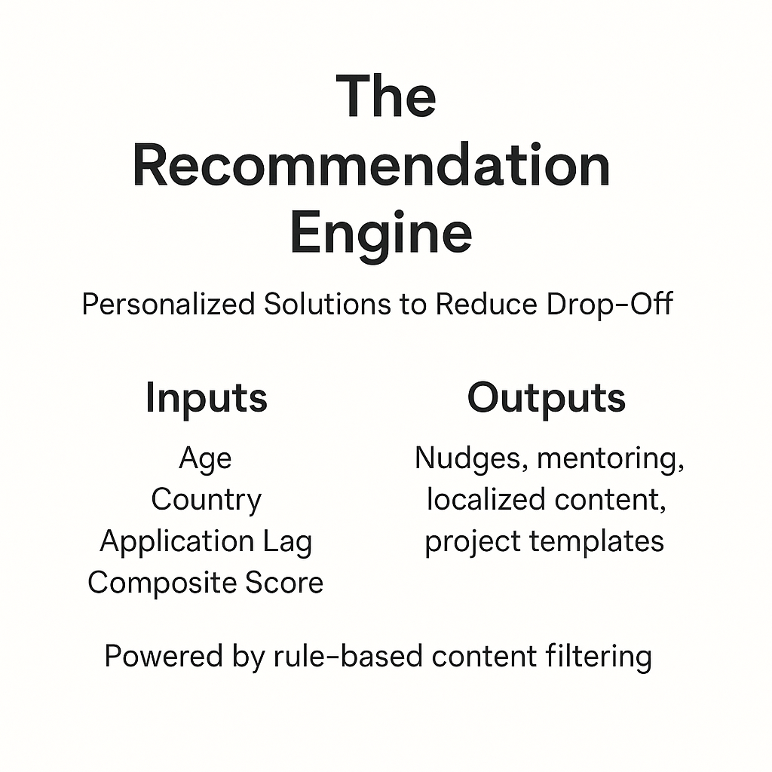
The Recommendation Engine
Personalized Solutions to Reduce Drop-Off
Inputs: Age, Country, Application Lag, Composite Score
Outputs: Nudges, mentoring, localized content, project templates
Powered by rule-based content filtering

Slide 10

Final Thoughts
Title: Reflection & Future Impact
Developed end-to-end AI skills: cleaning, modeling, and strategy
Realized data is powerful—but only if it's complete and well-used
Ready to bring these insights to real-world challenges

